Slide 1
College Community Schools 2023-24 Certified Budget Presentation
April 10, 2023

Slide 2
Purposes of Certified Budget:
Establish a maximum tax rate
Establish an estimate of budget year expenditures

Slide 3
General Fund
General Fund Budget is driven by two primary factors:
Supplemental State Aid
Set by State Legislature- 3%
Certified Enrollment
Count taken in October each year. (e.g. Count taken in October 2022 is used for FY2024 budget)

Slide 4
Supplemental State Aid

Slide 5
District Cost Per Pupil
Year | DCPP
FY19 | $6,736
FY20 | $6,880
FY21 | $7,048
FY22 | $7,227
FY23 | $7,413
FY24 | $7,635

Slide 6
Certified Enrollment

Slide 7
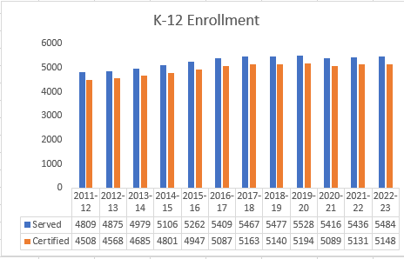

Slide 8
Components of General Fund Maximum Spending Authority
Combined District Cost
Instructional Support Program
Miscellaneous Income
Other SBRC Approved Authority

Slide 9
What is Combined District Cost?
Teacher Quality, Teacher Leader, Early Intervention, and Professional Development
TSS, TLC, EI, & PD
DOP/At-Risk Funding
Dropout Prevention/At Risk
AEA Flowthrough
AEA Flowthrough
Supplemental Weighting
Supplemental Weighting
Concurrent Enrollment, ELL, or other items times cost per student
Spec. Ed. Weighting
Regular Program Cost
Special Education
Weighting of SPED students times cost per student
Regular Program Cost
Number of students times cost per student.

Slide 10
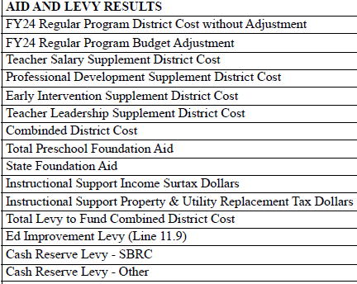
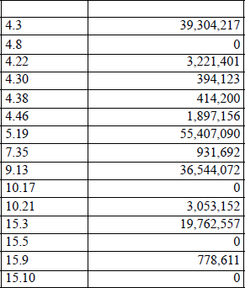

Slide 11
FY2024 Total Property Tax Levy
FUND | AMOUNT | RATE
General | $23,594,320 | $9.732
Management | $4,390,000 | $1.829
Reg. PPEL | $860,367 | $.33
Voted PPEL | $1,746,805 | $.67
Debt Service | $10,554,463 | $4.05
TOTAL | $41,145,955 | $16.61

Slide 12
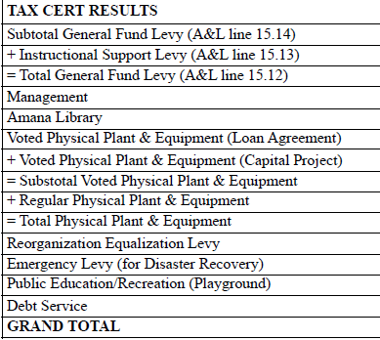
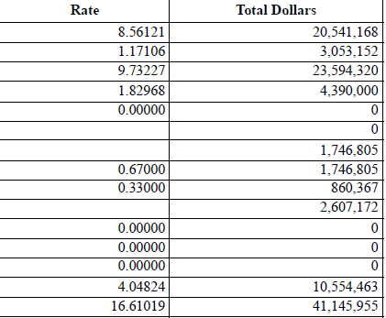

Slide 13
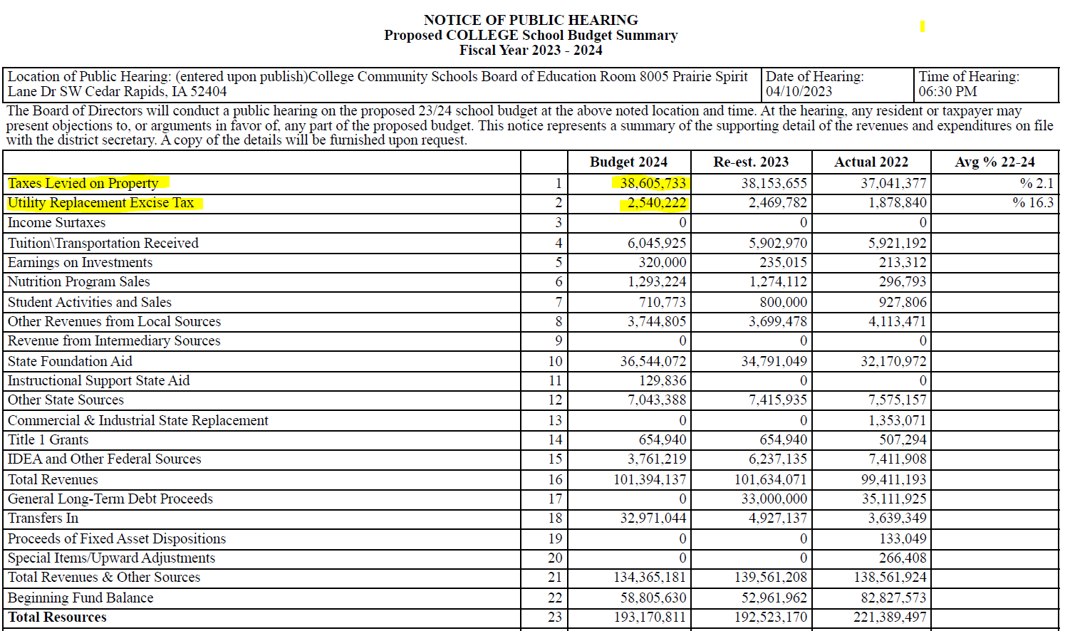

Slide 14
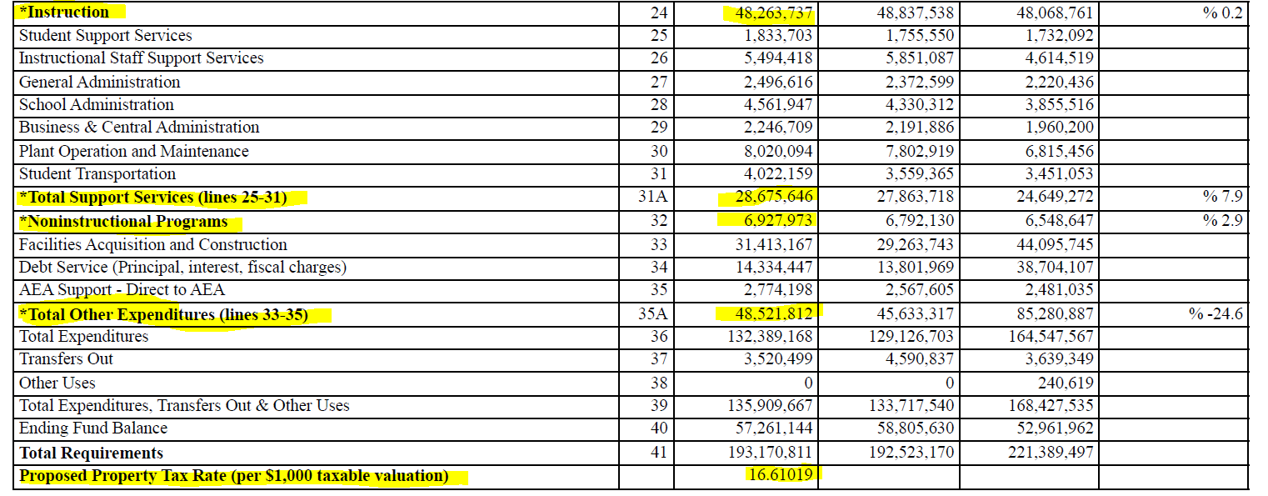

Slide 15
QUESTIONS?

